Slide 1
Op-Amps: Basics & Non-idealities
YR3-BE3-HBINST
Dept. of Bioengineering
E.M.Drakakis
Notes:
Op-amp one of the most fundamental components of electronics.
What does the op-amp do?
Measure the difference between two voltages, then that difference is amplified by a large factor (10⁵ , 10⁶ )

Slide 2
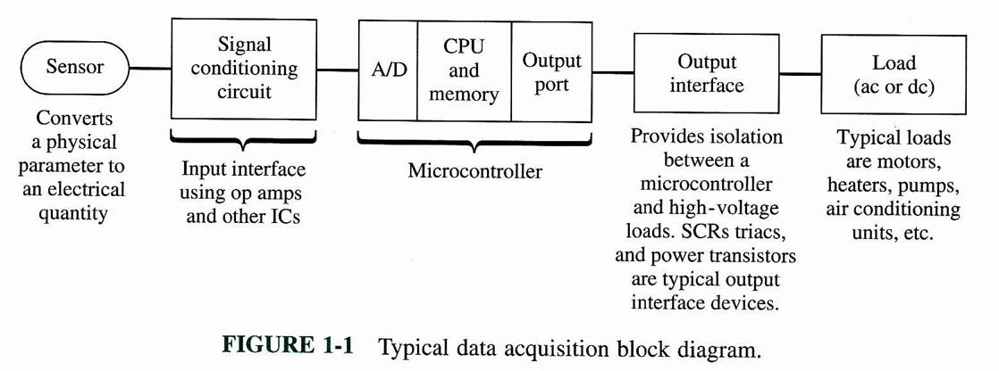
Do we need Analog Instrumentation
in a Digital world?
....ever thinner “analog shell” around the “digital egg”....
Notes:
In SCC, we usually have amplification, filters…
Then this signal is converted to digital so it can be manipulated computationally.

Slide 3
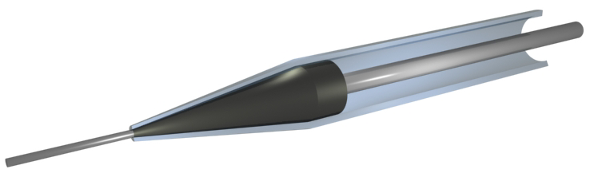
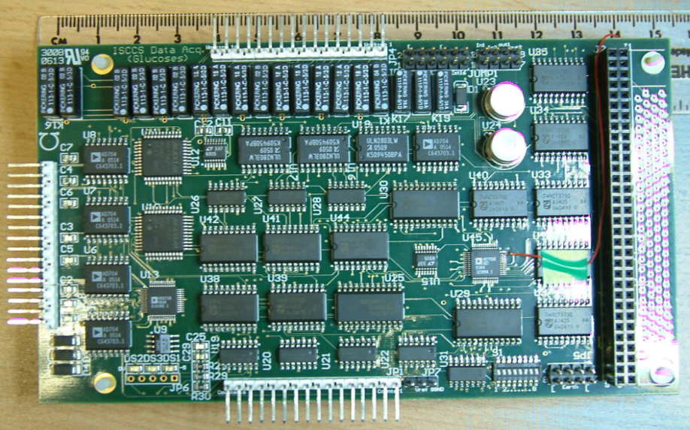
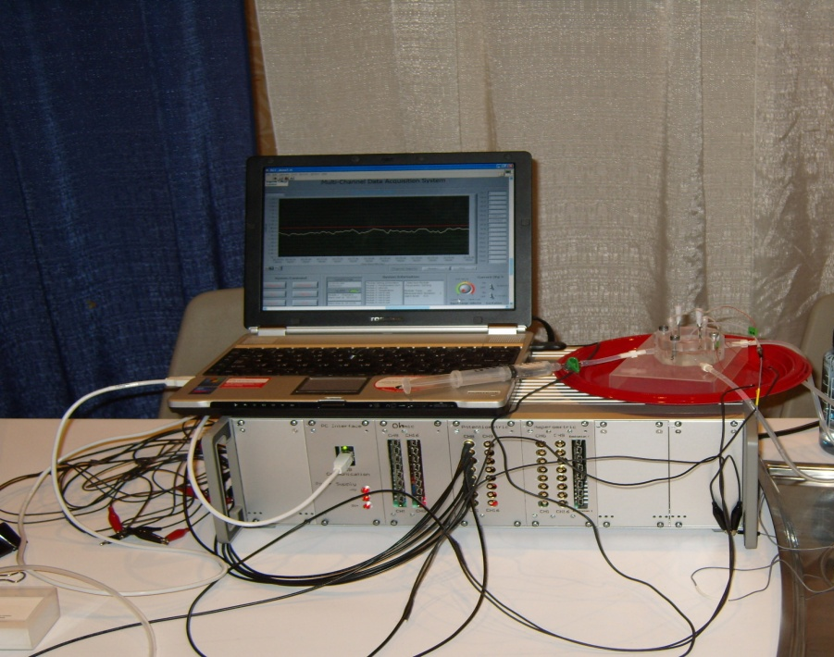
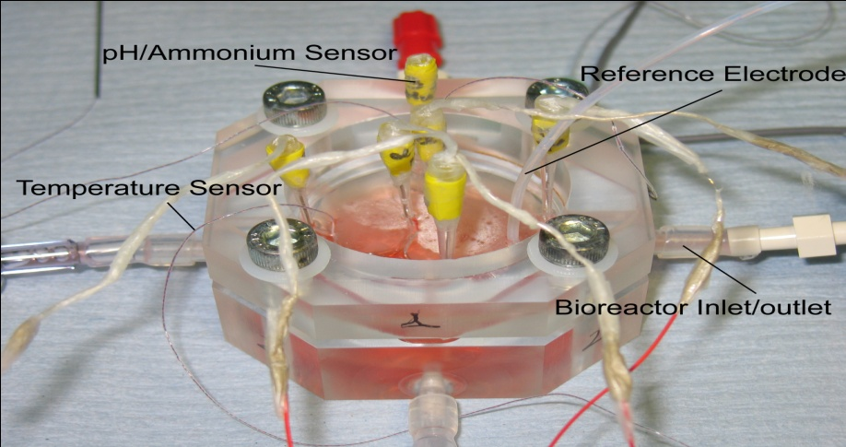
Bioinstrumentation Example I: A Practical Cell Culture Monitoring System
Miniaturised Sensors
Ag wire
2 mm
Wood’s metal
Glass capillary
Pt wire
0.2 mm
Potentiometric & Amperometric modules
Bioreactors
Notes:
Sensor to measure ammonia in cell cultures at different locations.

Slide 4

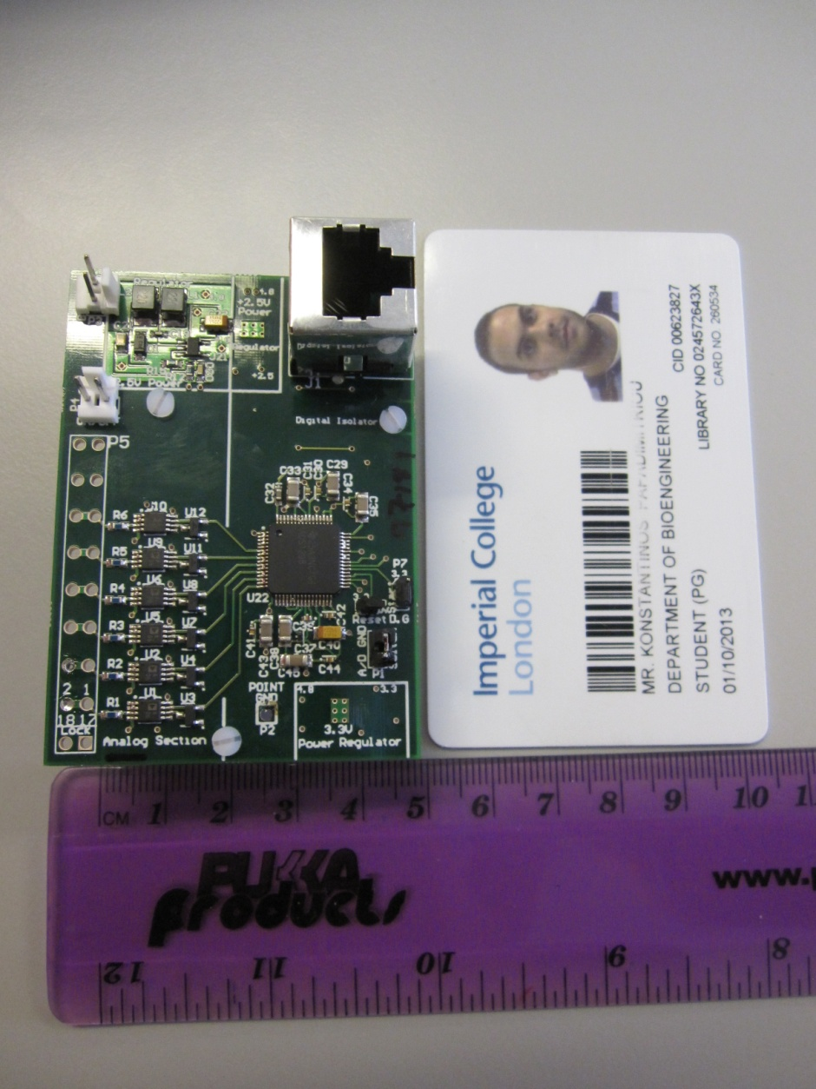
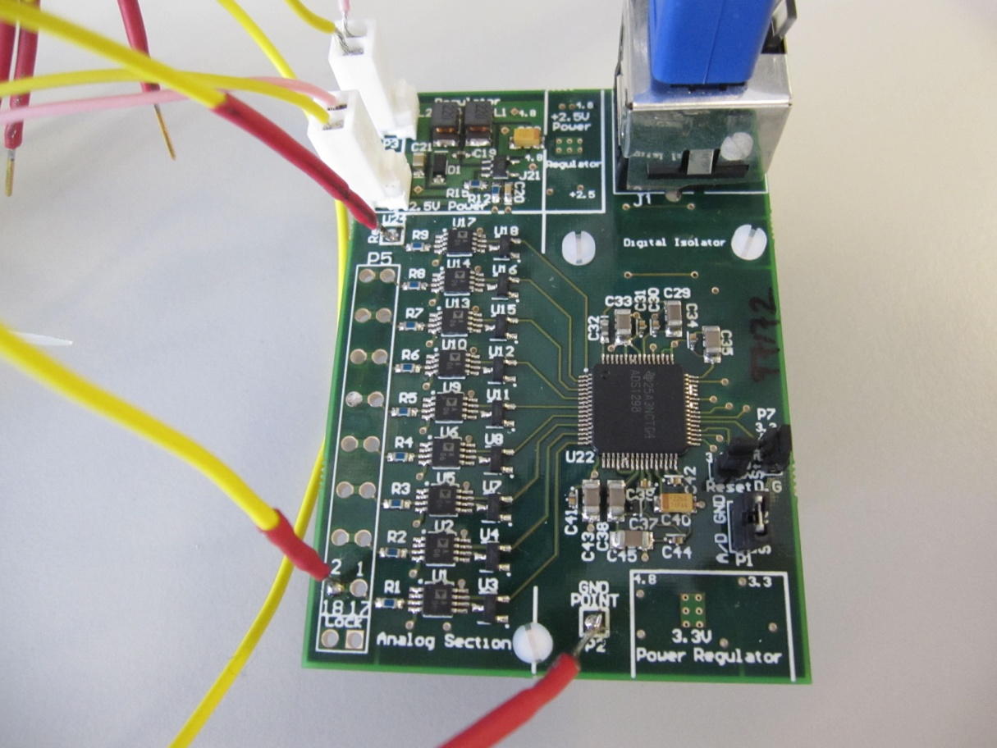
Bioinstrumentation Example II: Electrocorticography Instrument
Unipolar Analog ECoG Board
Bipolar Analog ECoG Board
Power Modules
Power Modules
Digital Isolator
Digital Isolator
Electrode
Input
Buffers & Amplifiers
Analog to Digital Converter
Analog to Digital Converter
Electrode
Input
Buffers & Amplifiers
Power Modules
Power Modules

Slide 5
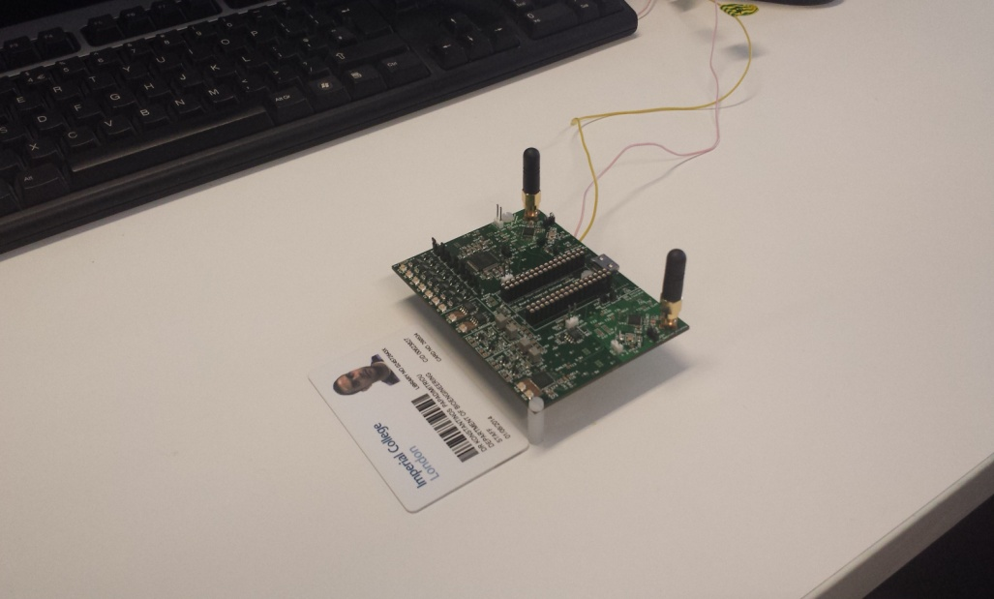
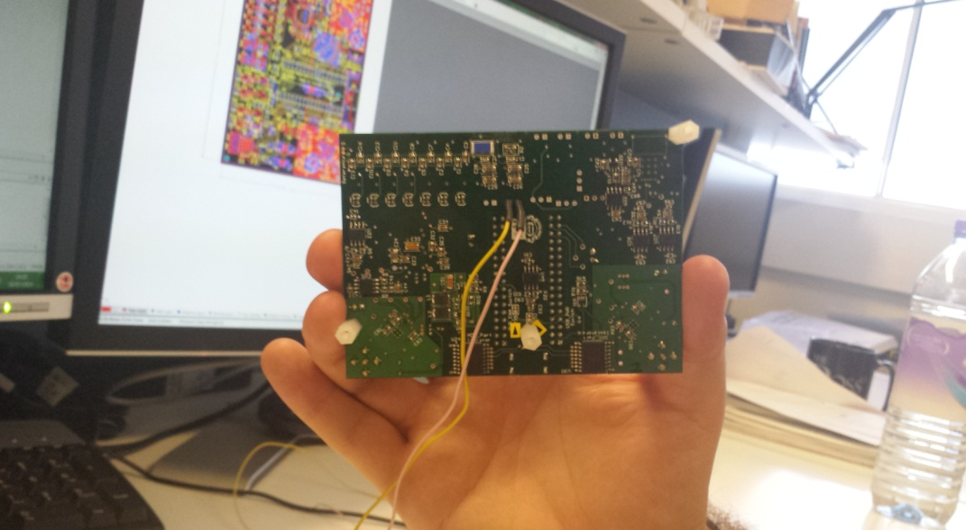
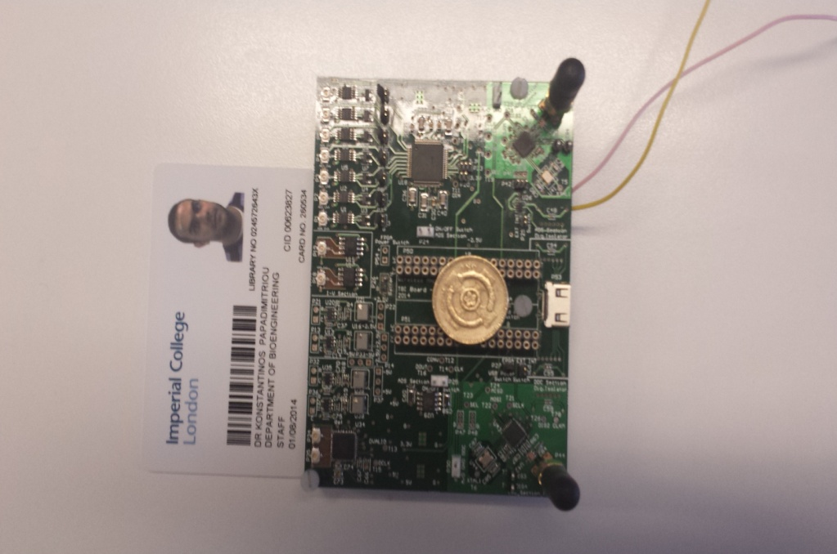
Bioinstrumentation Example III: Next Generation TBI Instrument:
Twin Wireless Neuroelectrochemical Monitoring
6 EcoG/Potentiometry channels
4 Amperometry channels
(2xDDC plus 2x I-to-V)
AT86RF231 radio chip
(2.45GHz; bita rate: 0.25-2Mbps)
EFM01-CESYS FPGA module
(Spartan3e – XC3S500E)
Notes:
Smaller sensors cause less trauma in tissue but are more difficult to work with for us.

Slide 6
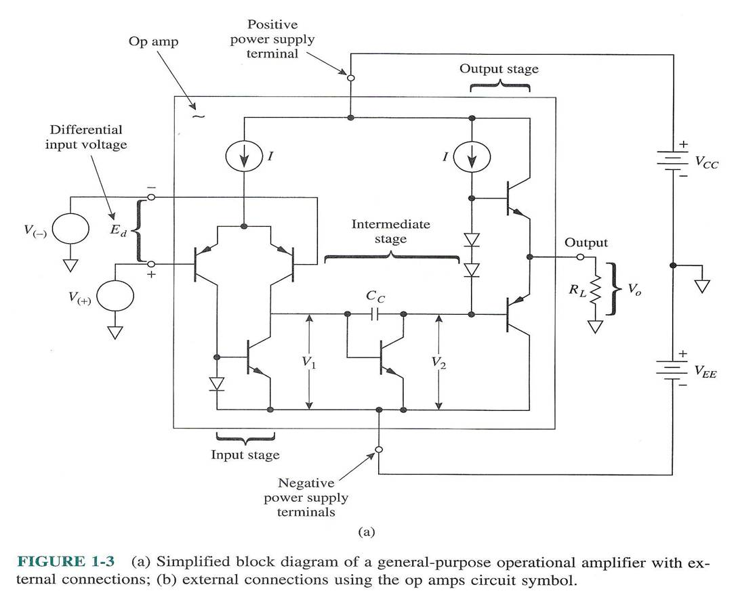
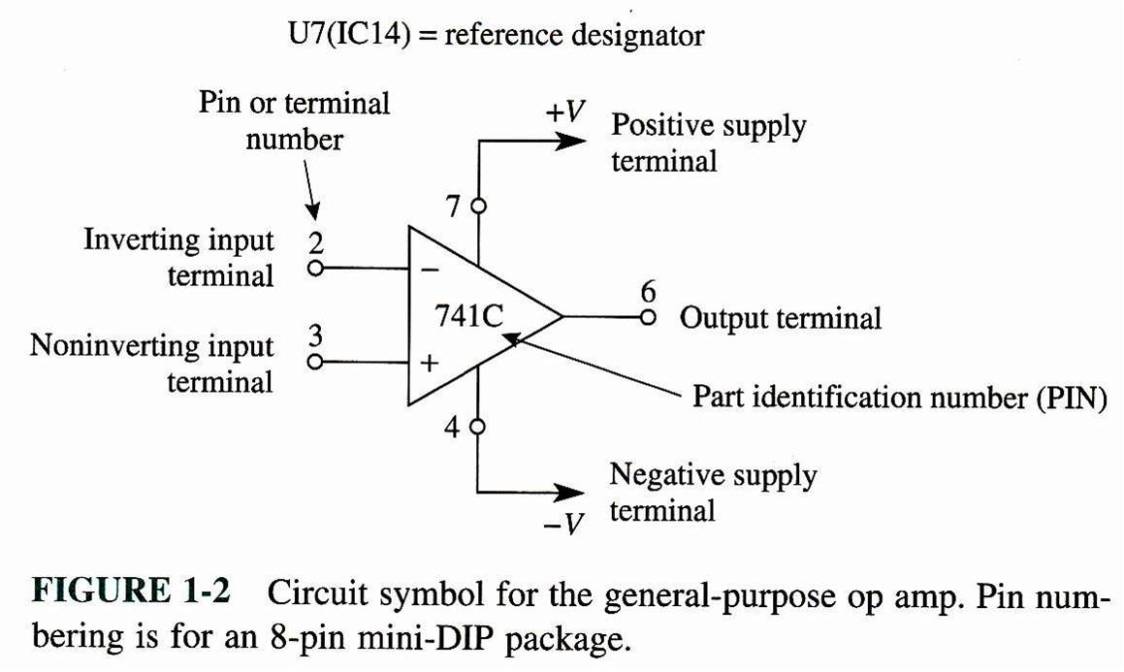
General Purpose Op-Amp

Slide 7
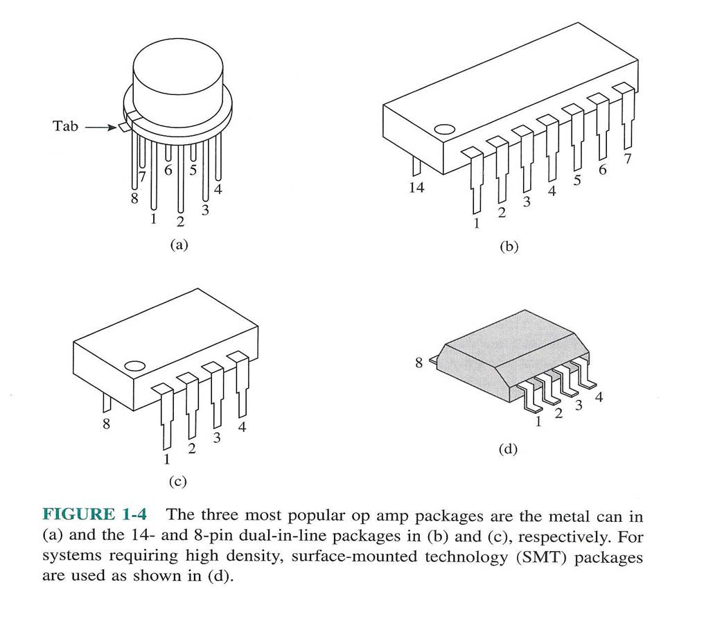
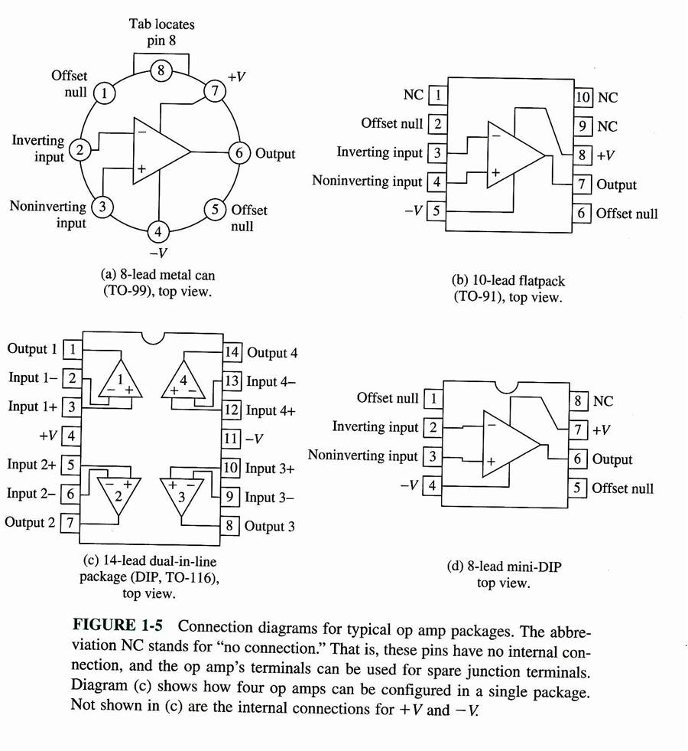
Op-Amp Packaging

Slide 8
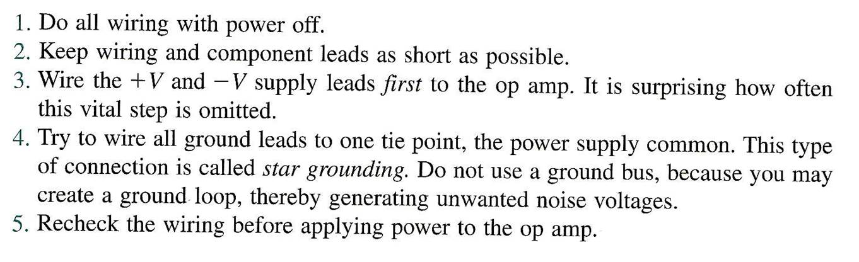
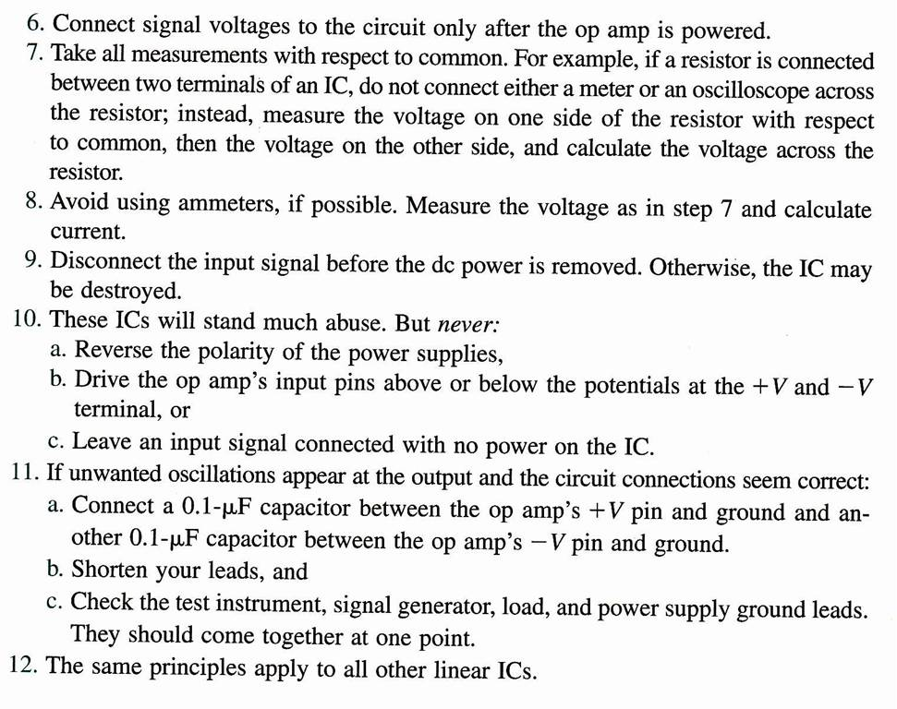
Breadboarding Practical Suggestions
Notes:
If we use a voltmeter to measure a voltage across a part of a circuit, as the voltmeter has a high input impedance it affects the circuit.
Instead we use an oscilloscope(which also has a very high input impedance) and we do the measurements one-by-one. This way the circuit results to be much less affected by the measurements.

Slide 9
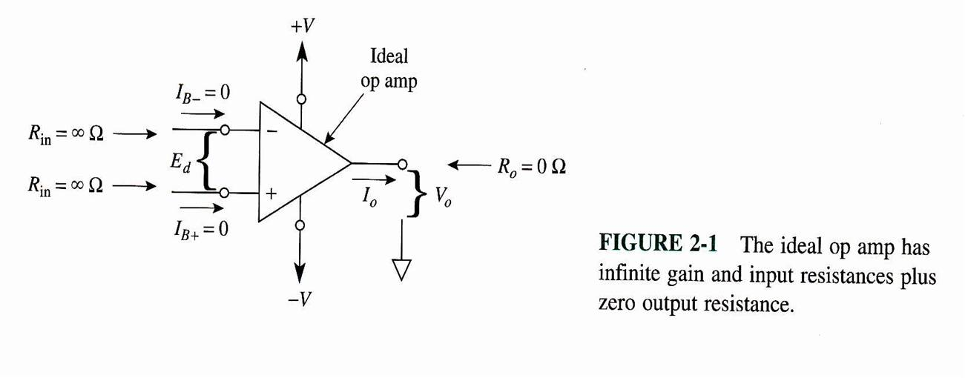
The Ideal Op-Amp
Notes:
In an ideal op-amp voltage V_{out} would be equal to:
$$V_{out}= A_{d}∙\left(V_{+}−V_{−}\right)$$
Where A_{d} is the differential gain of the op-amp.

Slide 10
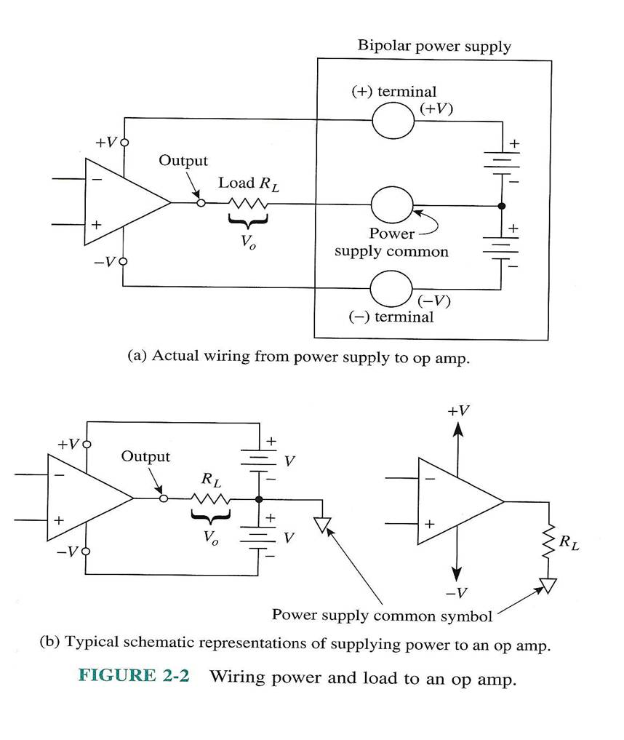
Wiring-up the Op-Amp

Slide 11
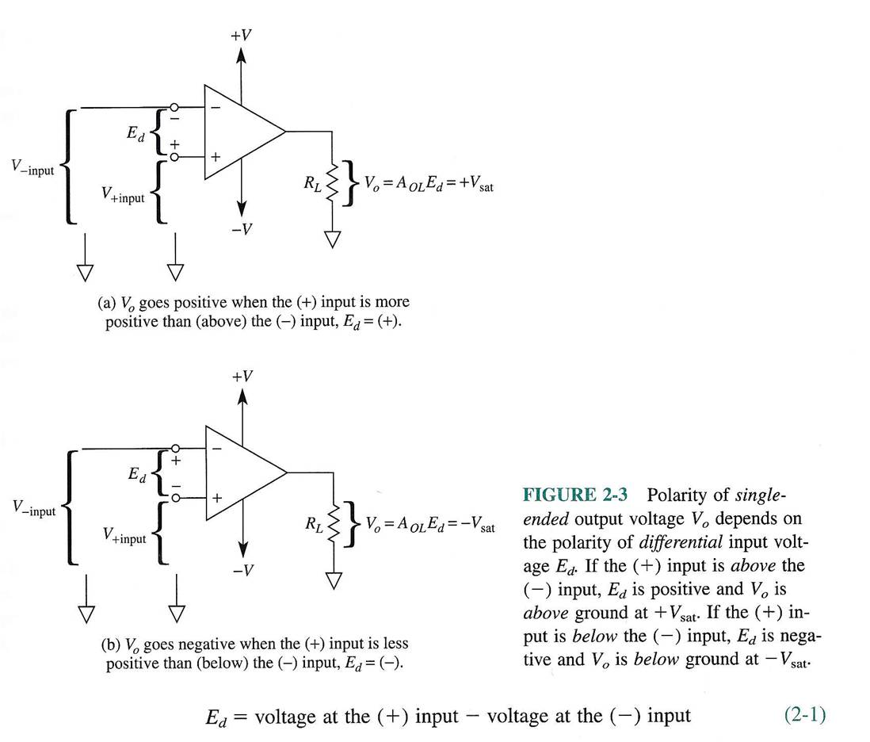
Open-loop Op-Amp

Slide 12
Open-loop Voltage Gain
V_{out}= E_{d} x (open loop gain)
BUT
Open loop gain is large!! (~ 10^5) =>
In “open loop” the op-amp behaves as a linear amplifier only for MINUTE
Input differential voltages which is impractical! =>
To maintain V_{out} between useful limits Op-Amps are used in feedback configuration
Notes:
Open loop voltage gain is not very useful as linear region is limited by a narrow range of values for ∆V_{in}.

Slide 13
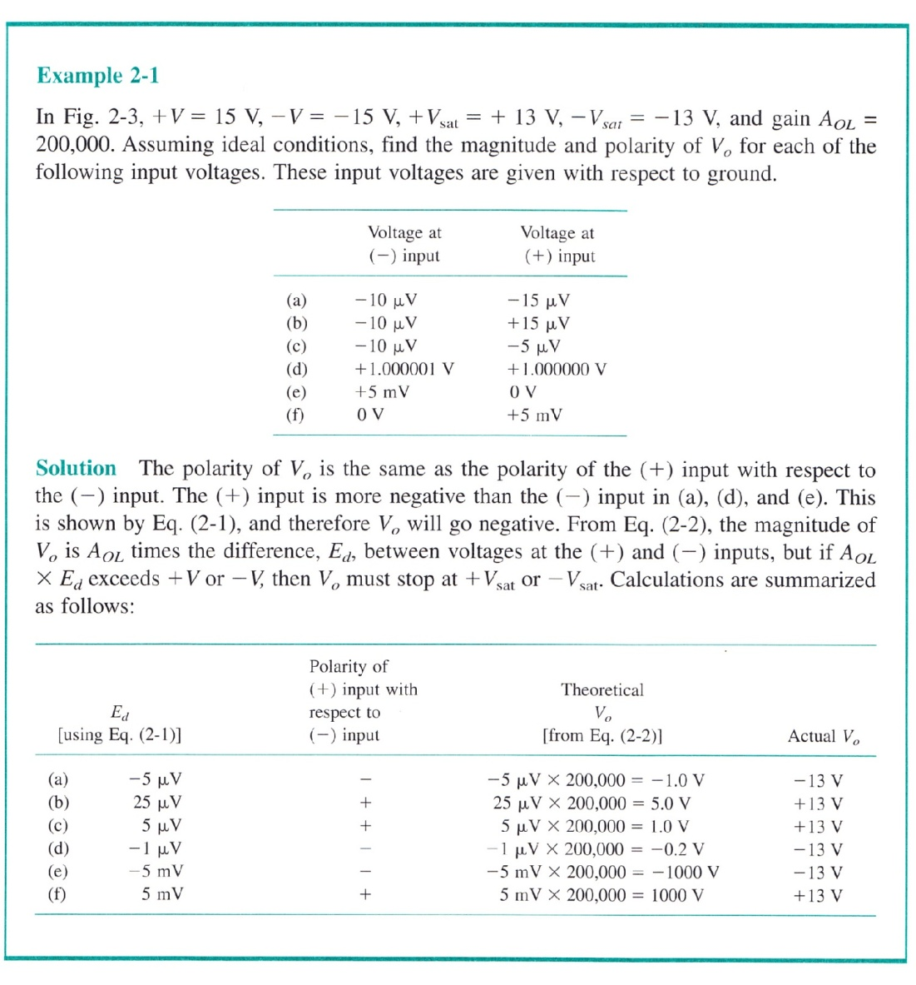
Open-loop Operation Example
Notes:
If A_ol * Ed exceeds +V or –V then V0 must stop at Vsat+ or Vsat- respectively

Slide 14
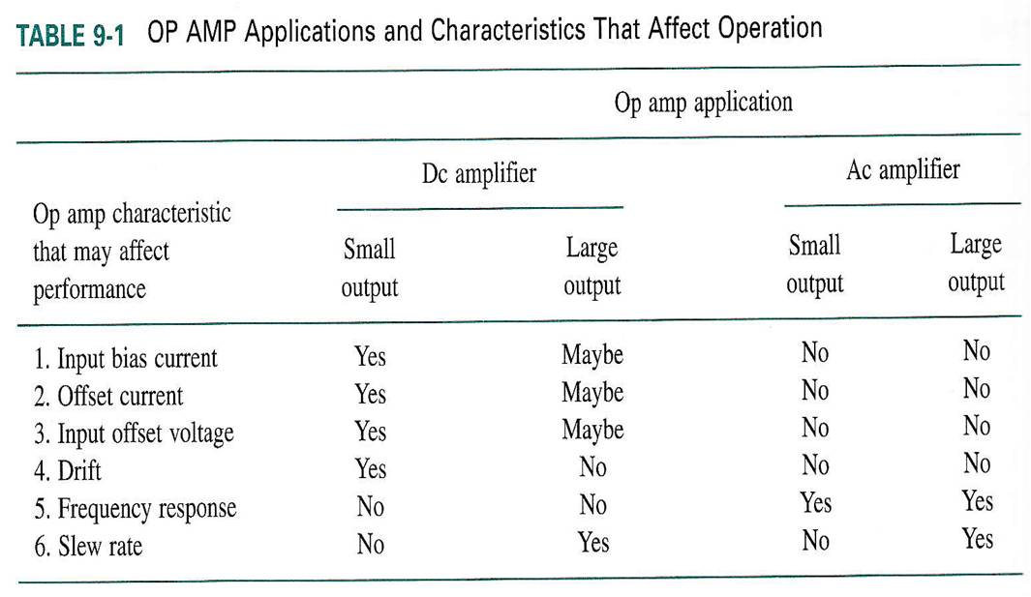
Op-Amp Non-idealities

Slide 15
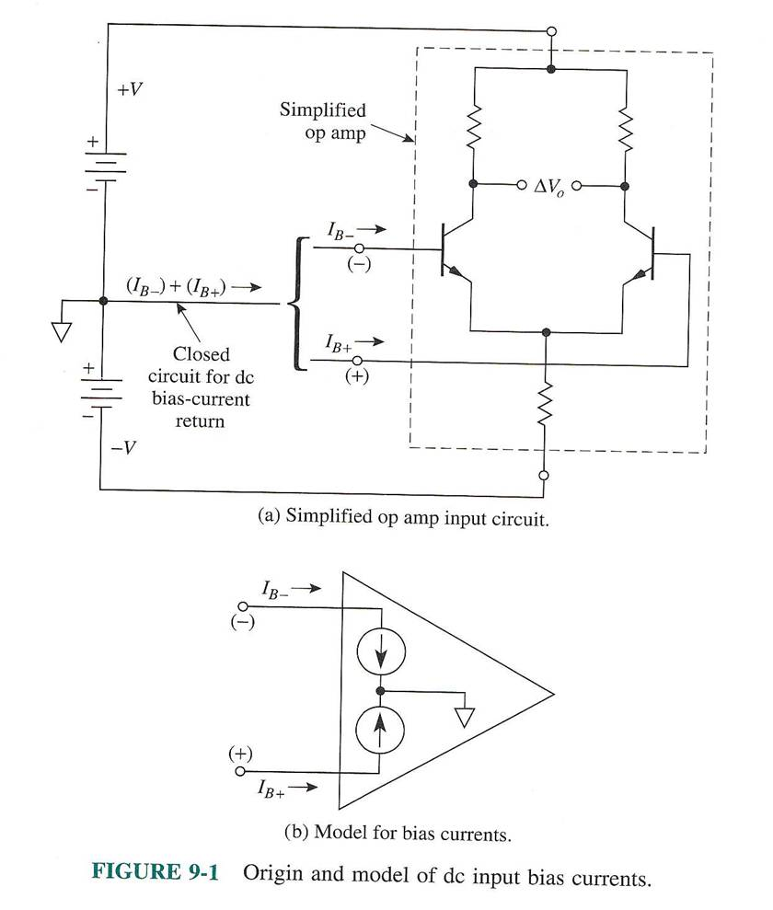
Input Bias Current
Notes:
Drift: aging and temperature component changes

Slide 16
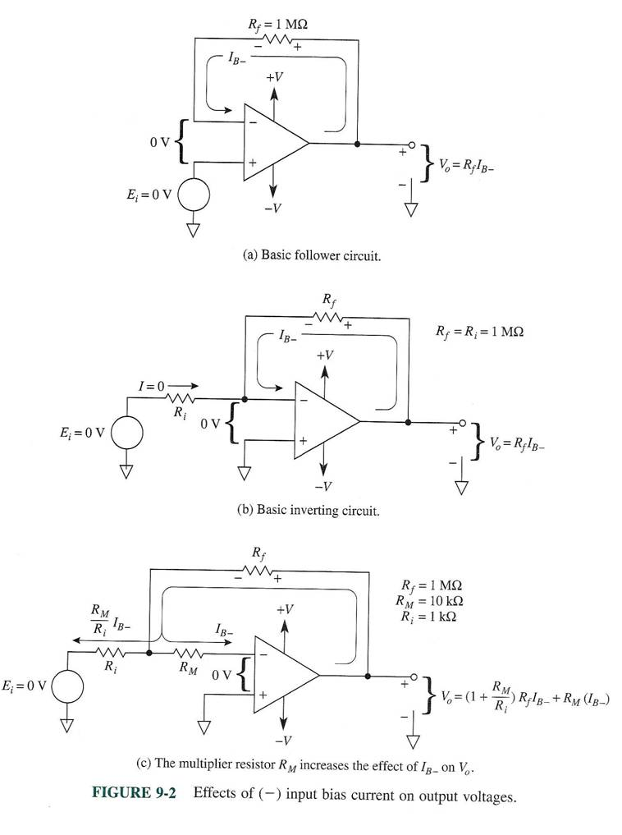
Effect of –ve Input Bias Current
Notes:
Negative feed-back loop (figure a) will set a current off-set, known as parasitic input current(I_{B}). Hence induces a voltage off-set as I_{B} goes through R_{f}.
In the circuits in these 3 figures there is amplification, can quite easily be worked out.
When measuring voltages in this kind of circuits we can always subtract these systematic off-sets from our measurements.

Slide 17
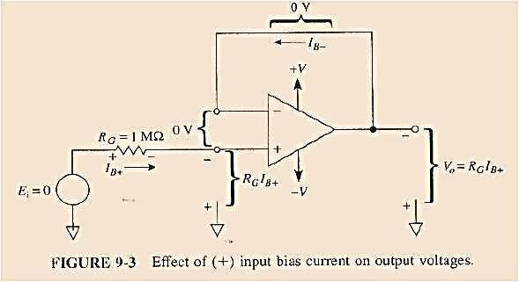
Effect of +ve Input Bias Current

Slide 18
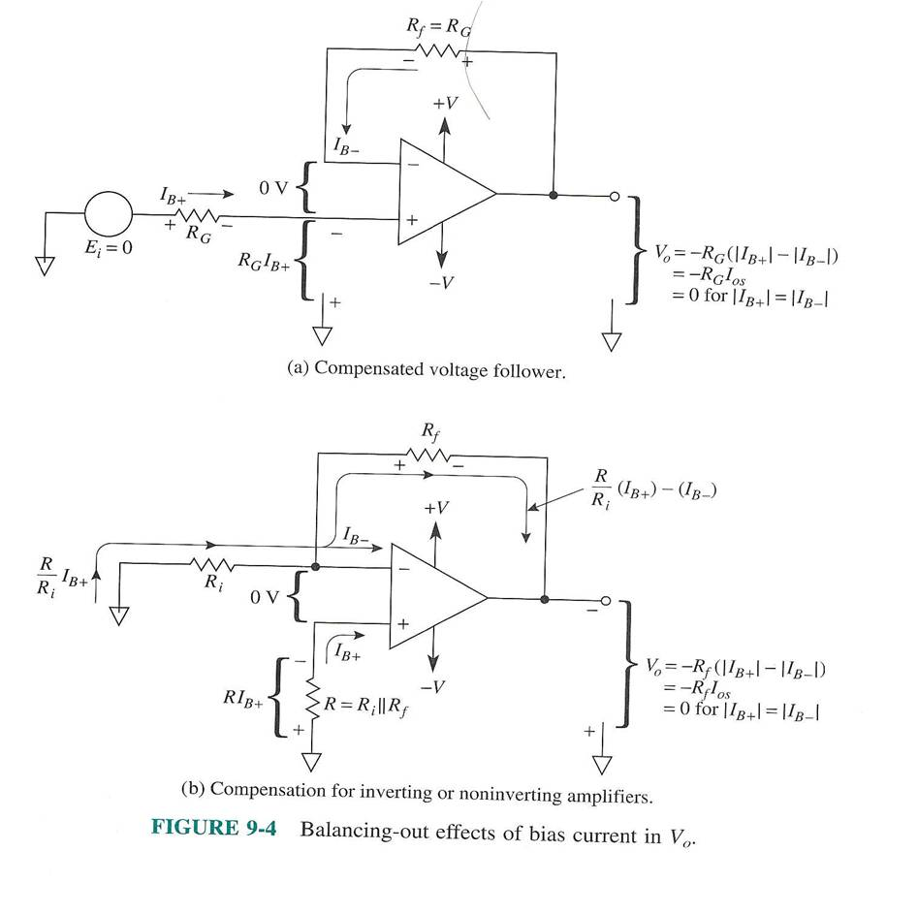
Compensation for equal input bias current values

Slide 19
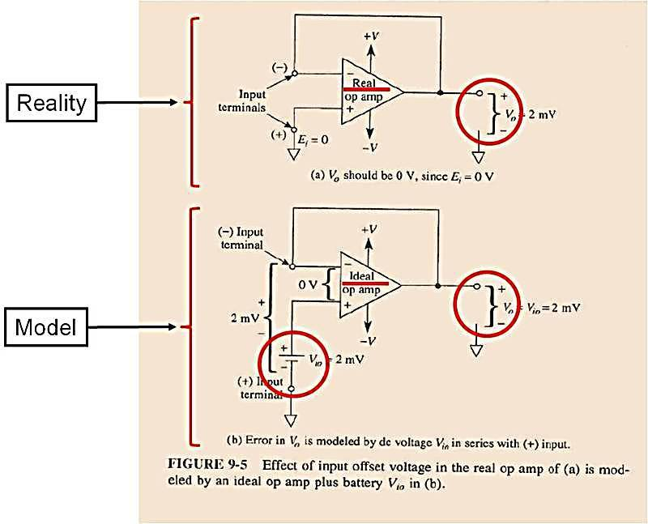
Input Offset Voltage

Slide 20
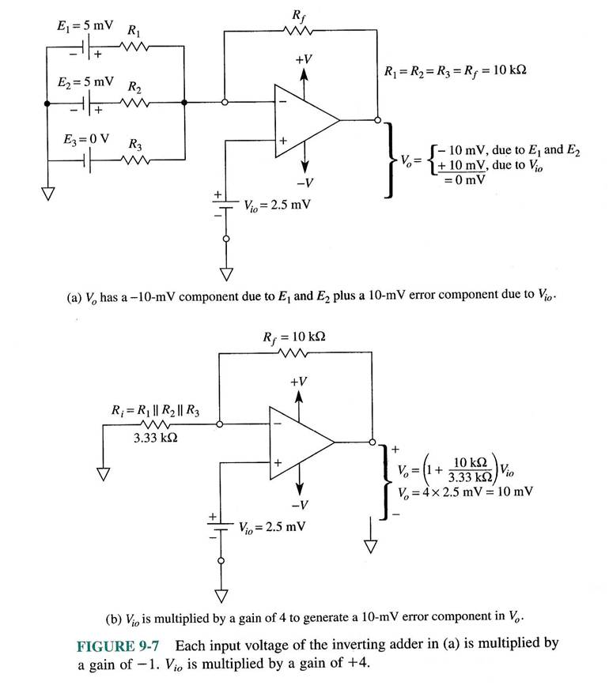
Signal Gain vs. Input Offset Voltage Gain:
the inverting adder example
Notes:
Because the inverting adder is a linear system we can use the superposition principle to analyze tis circuit by considering each voltage/current individually.

Slide 21
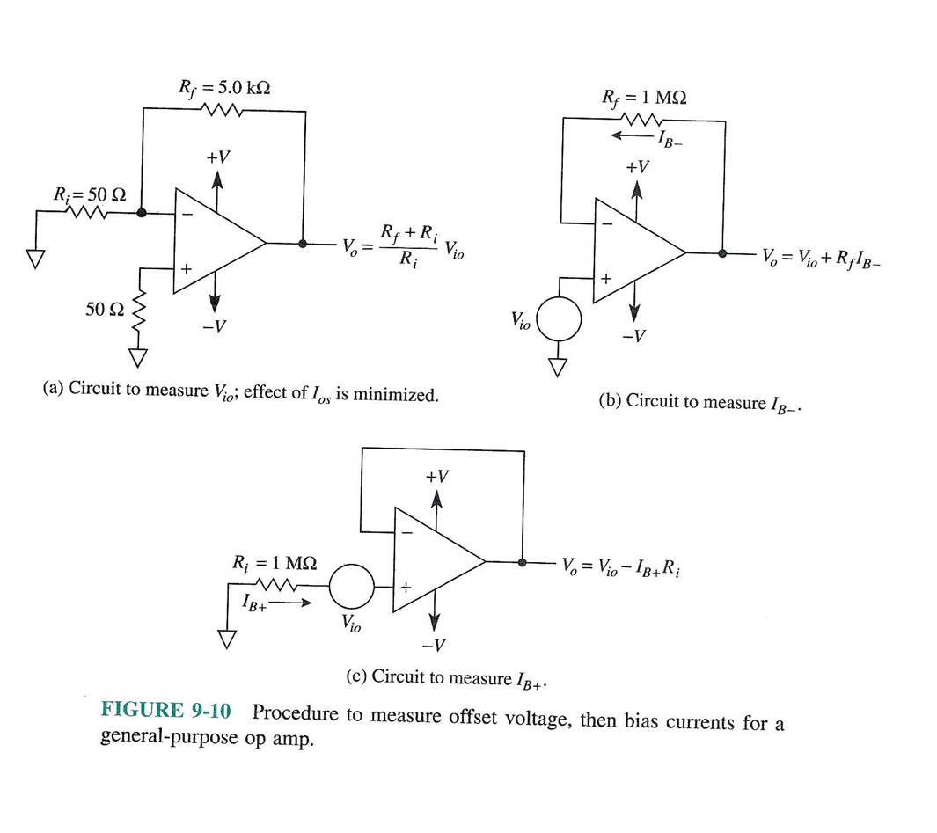
Measurement of Input Offset Voltage

Slide 22
Active Filter Basics
YR3-BE3-HBINST
Dept. of Bioengineering
E.M.Drakakis

Slide 23
What is a Filter? What is its effect?
(fill in)

Slide 24
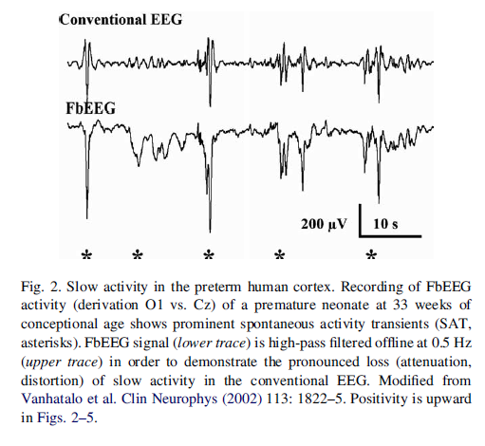
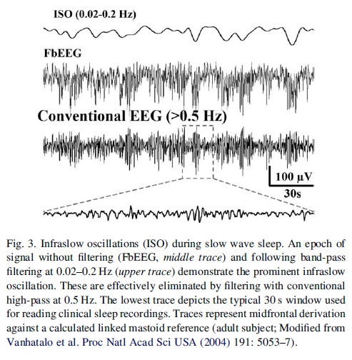
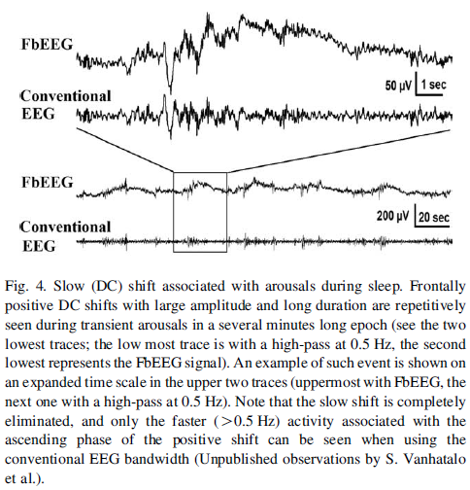
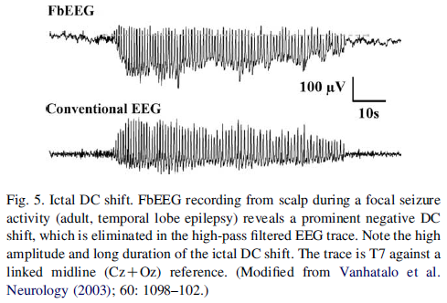
Filter effect example: Conventional EEG vs. FBEEG
Notes:
Filters alter information and it can be good or bad
Examples are full band EEG and conventional EEGs

Slide 25
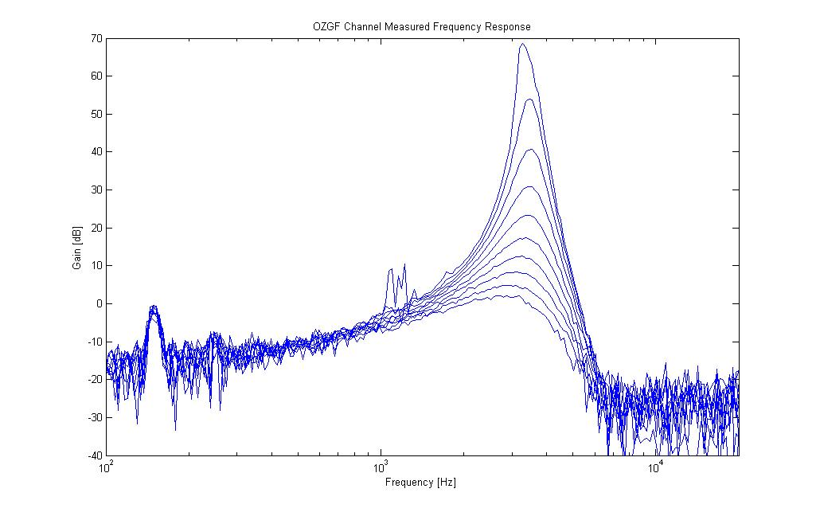
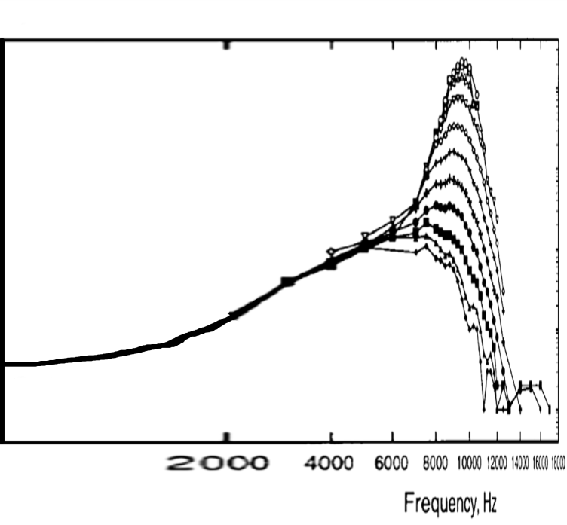
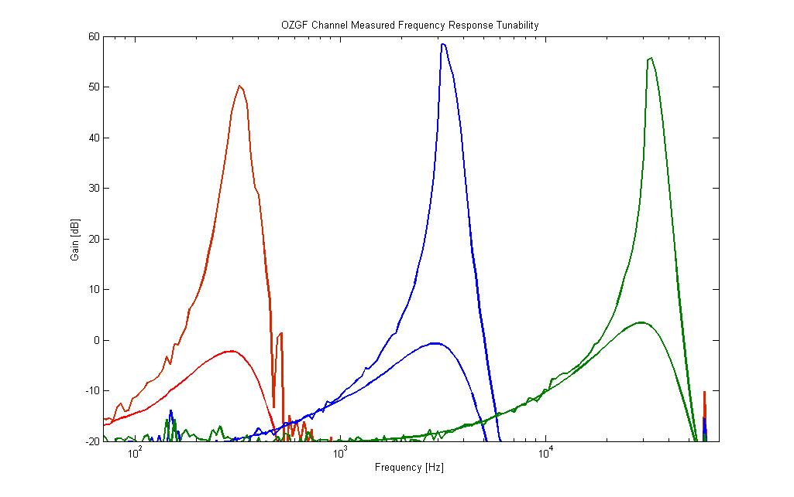
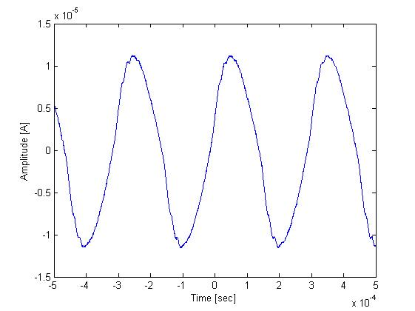
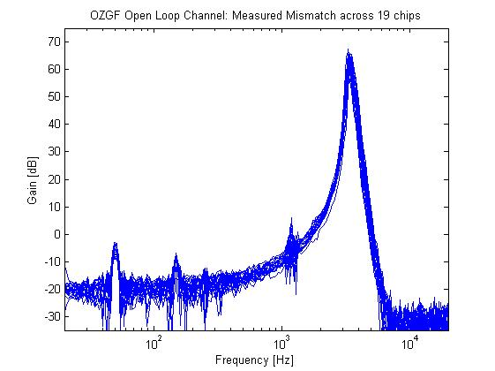
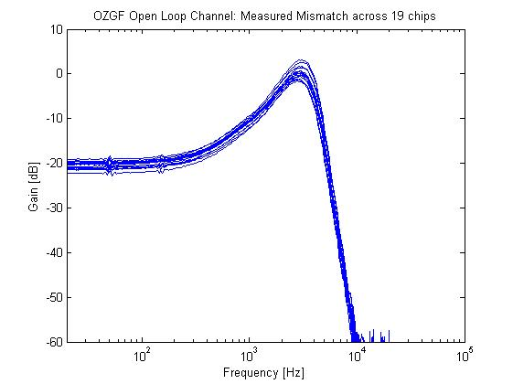
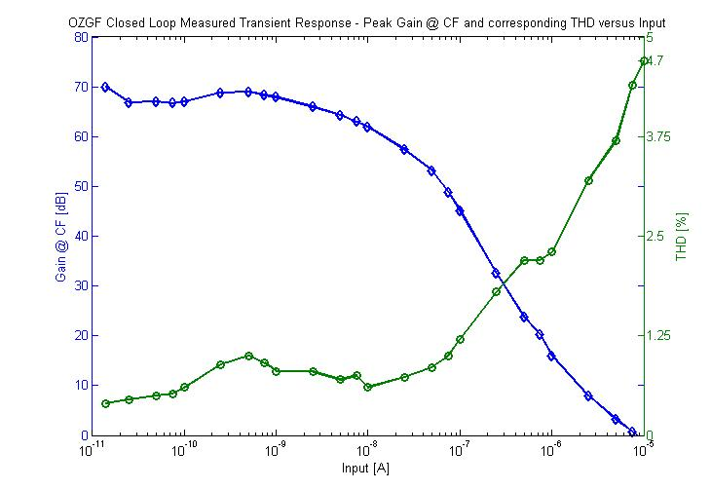
Biomimetic Bionic Cochlea Chip 1 Filter Example: Measured Results

Slide 26
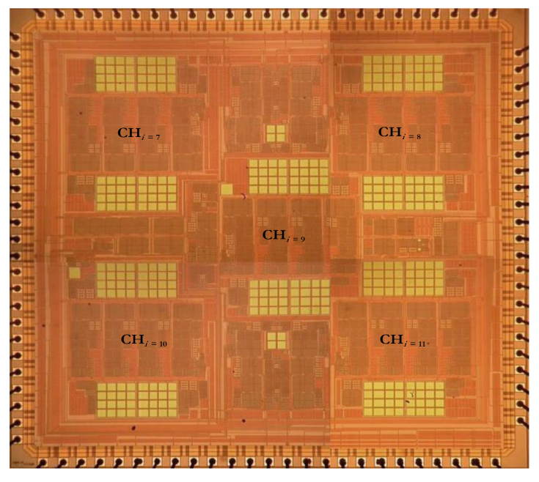
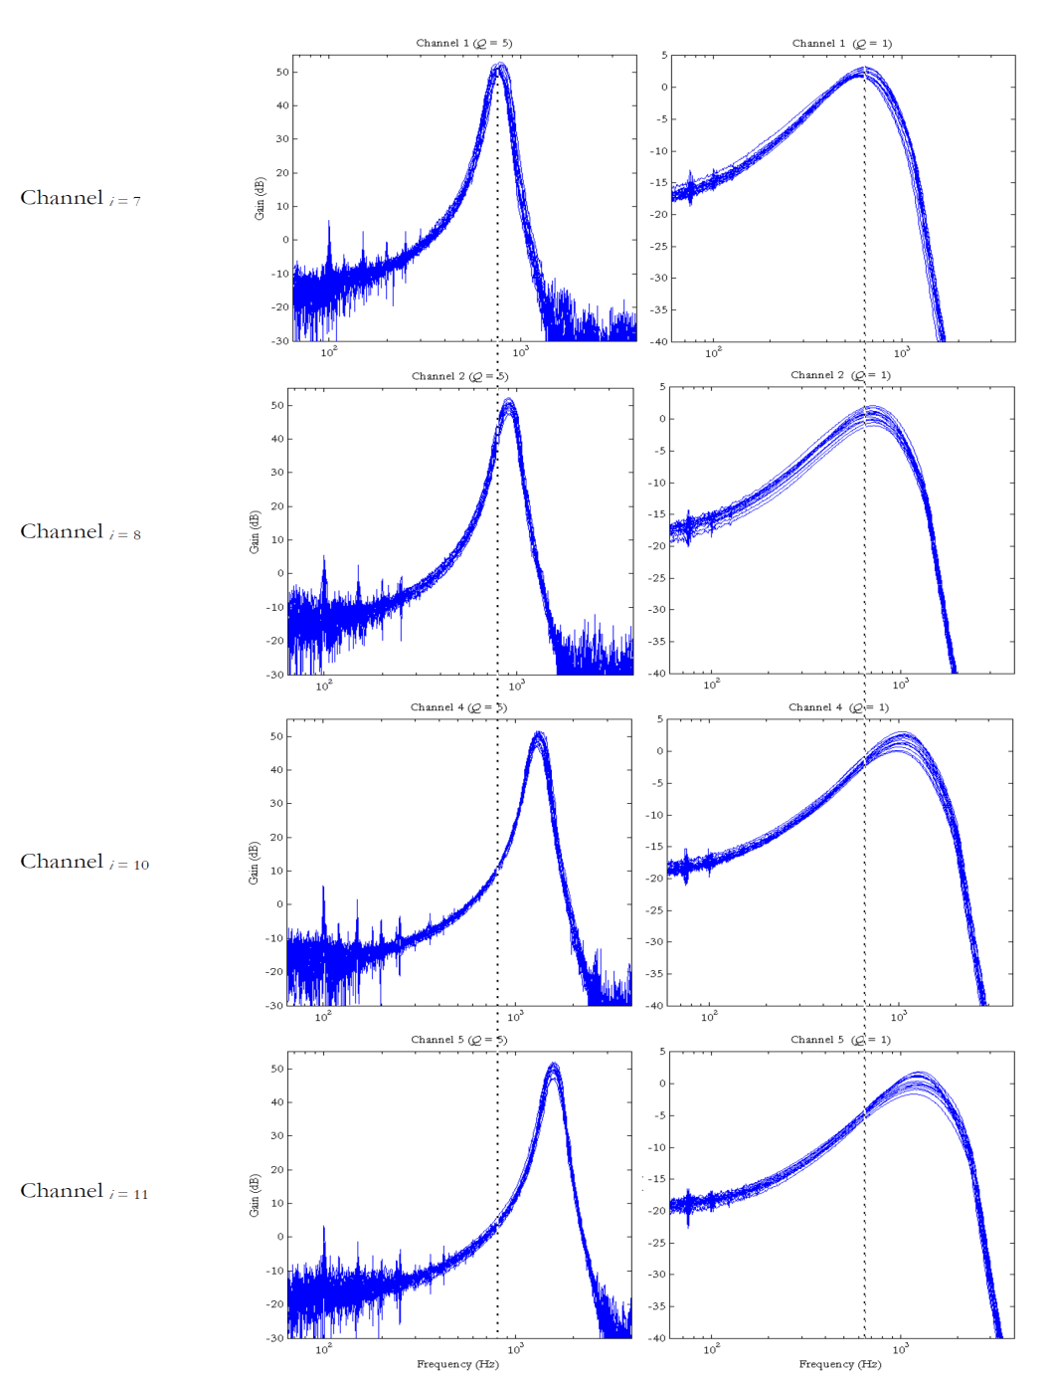
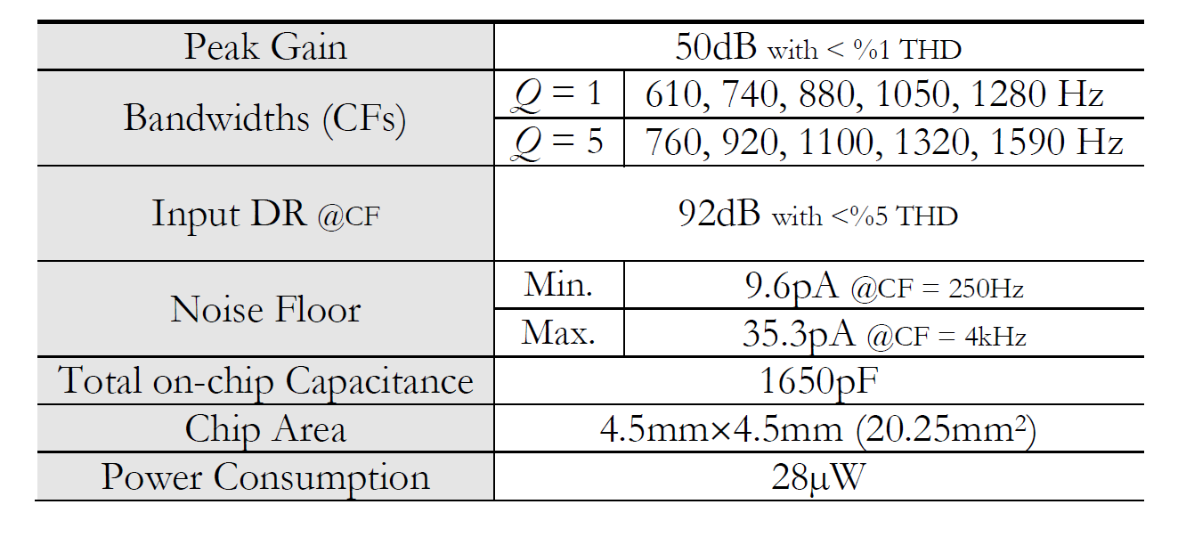
Bionic Cochlea Chip 2: Measured Results

Slide 27
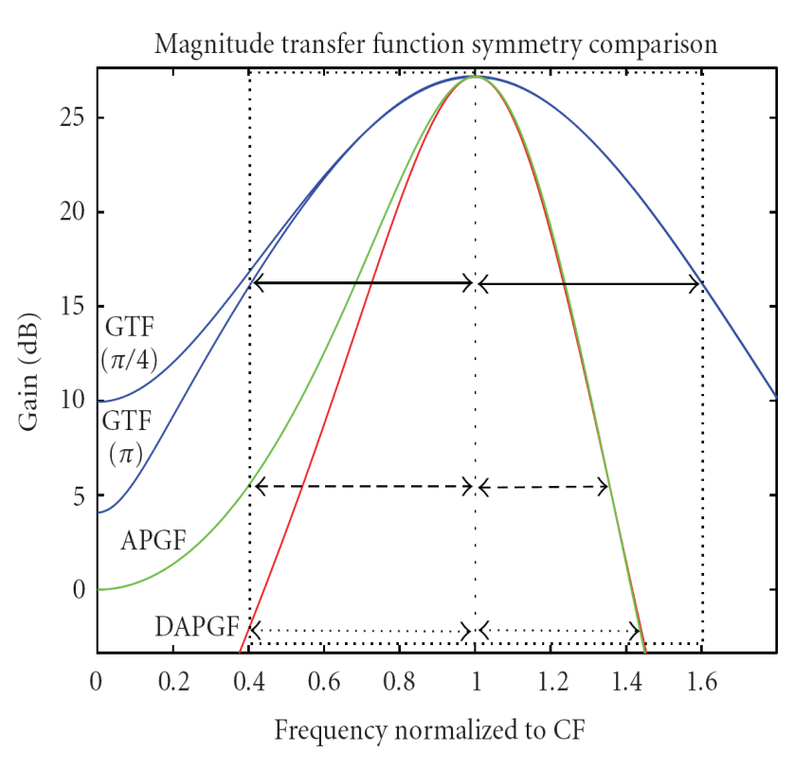
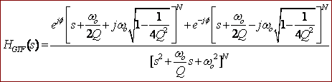
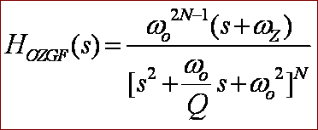
Gammatone-like Filters Modelling the operation of
A Basilar Membrane Segment
 | Frequency Domain Description | Intensity Dependent Parameterisation | Biomimicry
GTF |  Very Complex |  Not Easy |  Symmetric in the passband
OZGF |  Efficiently Implementable |  Single-parameter needed |  Asymmetric In the passband
Notes:
OZGF = ONE ZERO GAMMATONE FILTER

Slide 28
Basic 1st & 2nd Order Active Filters

Slide 29
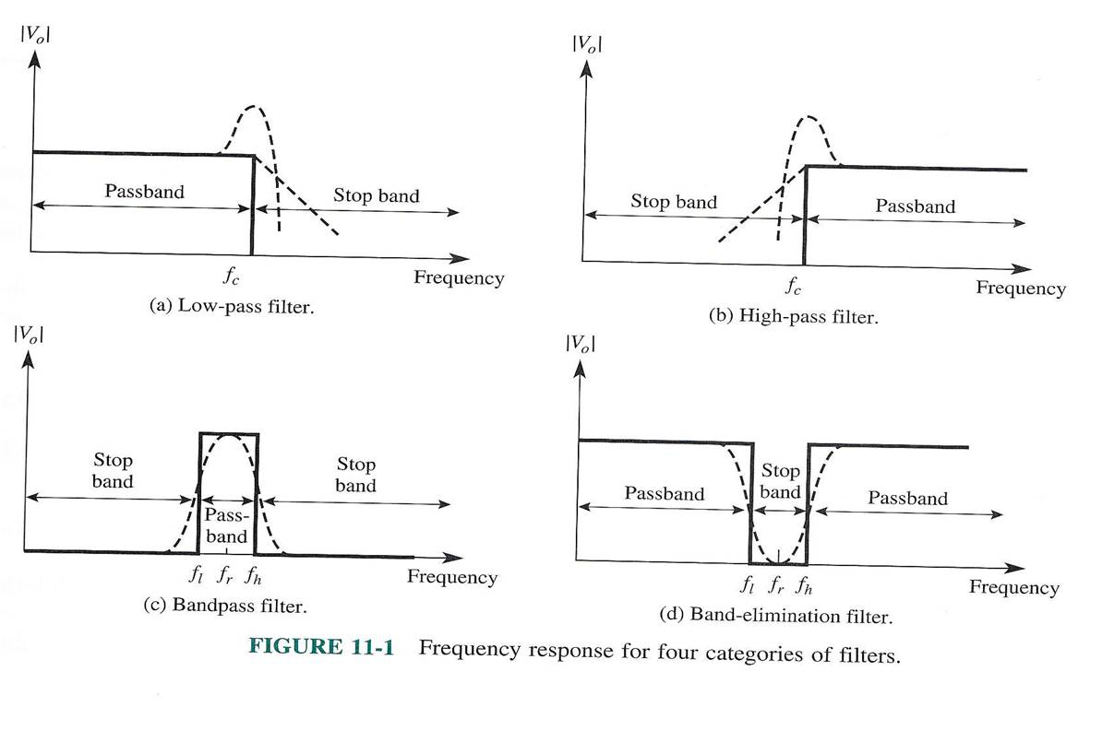
Basic Types of Filters

Slide 30
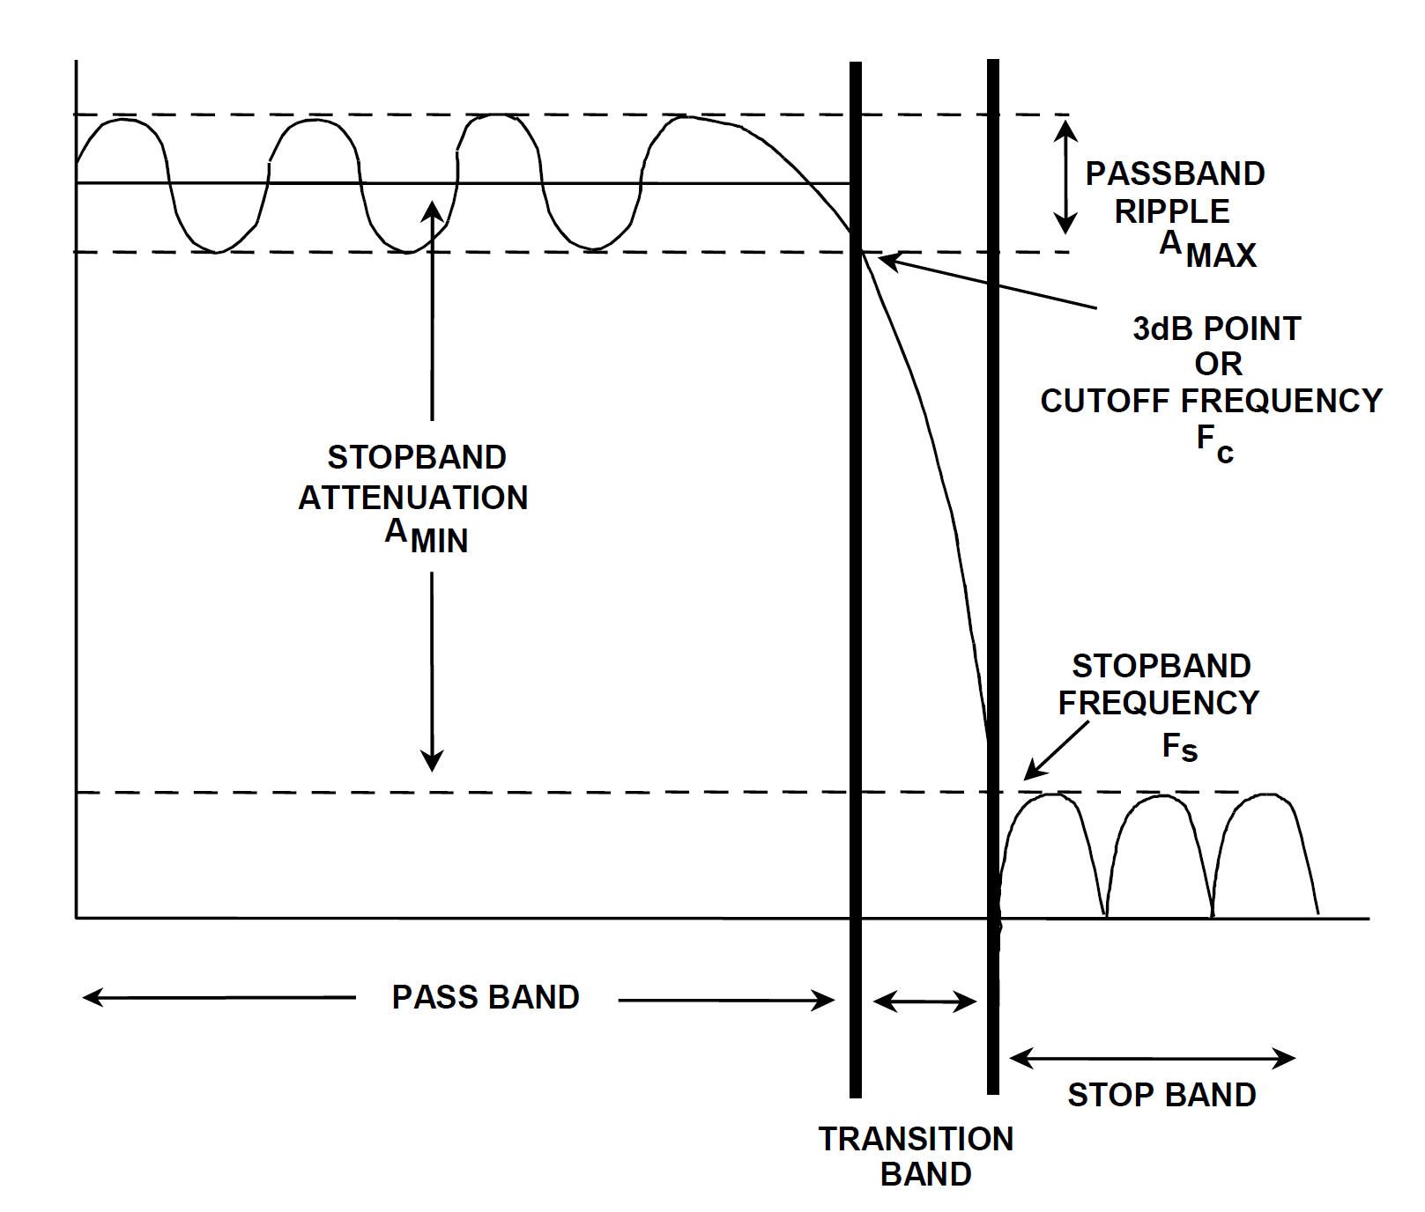
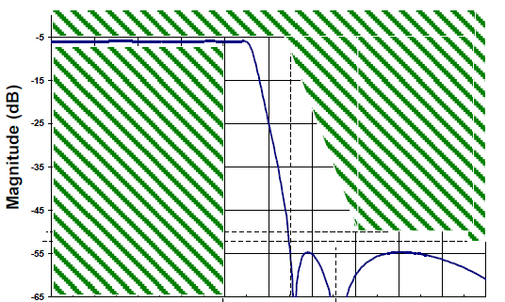
Choosing a proper Transfer Function for given specs
Specs
A possible (not unique!)
Transfer function which
Satisfies the specs.

Slide 31
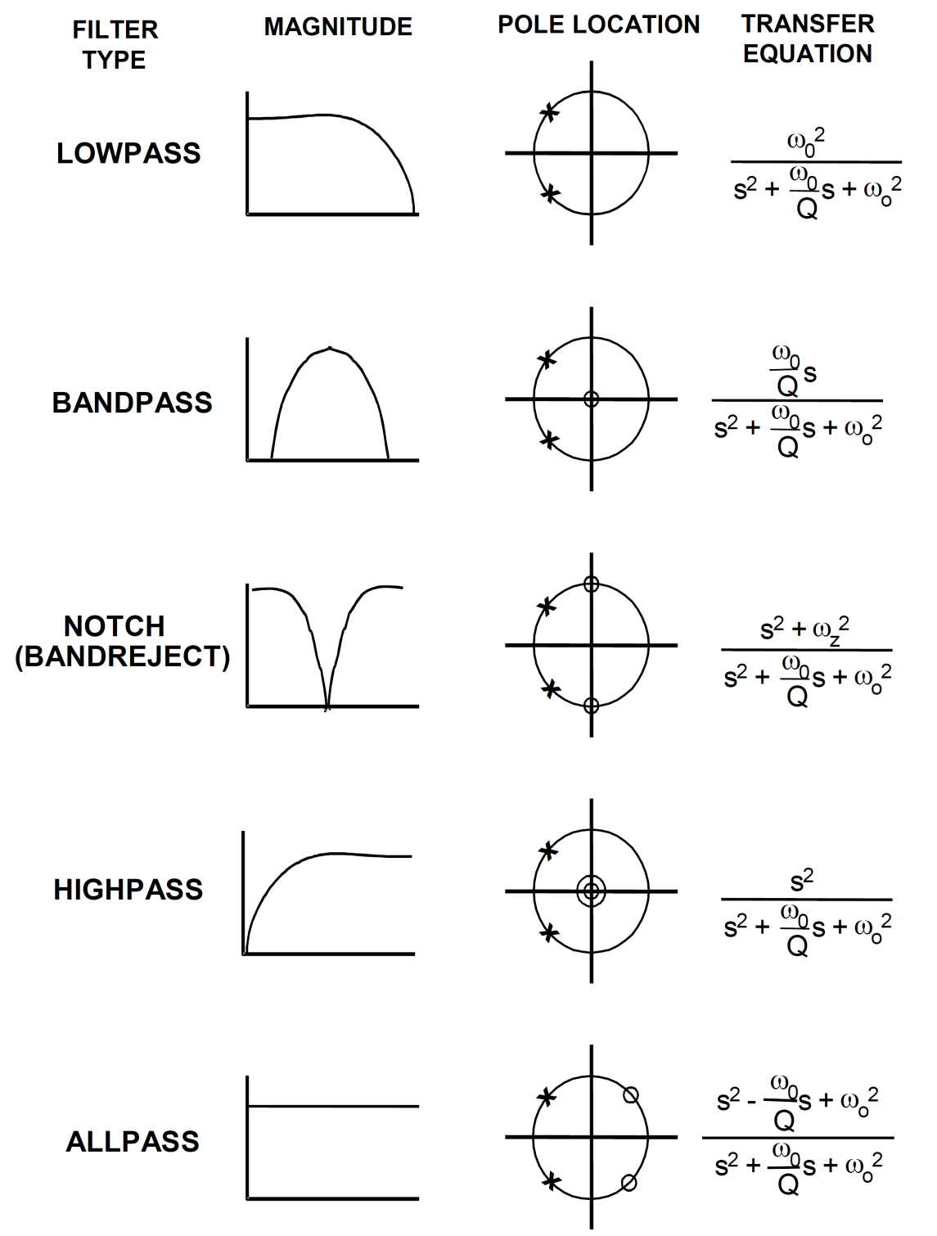
Basic Transfer functions of Biquadratic responses
Notes:
All pass filters can be used to change the phase of the signal but doesn't affect the magnitude(in passing region) or frequency.
w₀ is the pole frequency

Slide 32
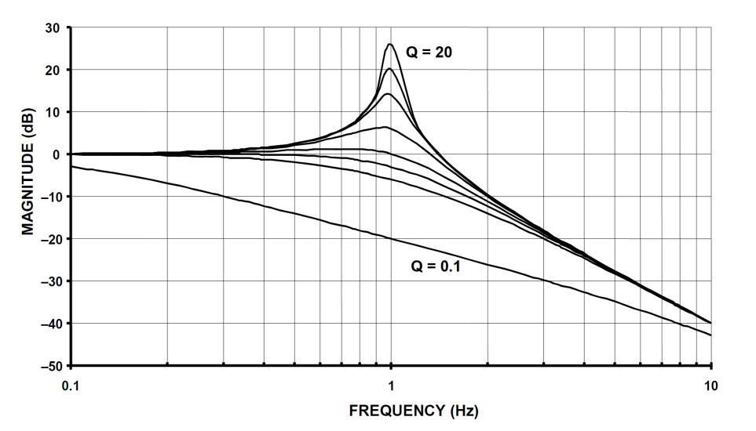



Effect of Q-value upon biquadratic responses
Notes:
Q: quality factor of the filter
As the Q increases poles come closer and closer to the imaginary axes and once they cross this axis, the circuit becomes an oscillator consindering non ideality of op-amp and other omponents

Slide 33


Phase responses of biquads

Slide 34

Basic Low-Pass Filter

Slide 35


Derive the LP TF & the Bode Magnitude Plot

Slide 36

Hz vs. rad/s

Slide 37

-40 dB/Dec LP Butterworth
Notes:
2 capacitors --> 2nd order response or less and so on

Slide 38
Derive the -40 dB/Dec LP TF

Slide 39
A general purpose topology: derive the general transfer function
(fill in)

Slide 40

Basic High-Pass Filters

Slide 41


+20 & +40 db/Dec HP Filters
What do you observe when you compare with LP topologies?
Notes:
To change between low pass and high pass you change capacitors for resistors and viceversa.

Slide 42

Band-Pass Filters
B(andwidth) = f_{h}-f_{l}
f_{r}= √ (f_{h}×f_{l})
Q= f_{r}/B
Notes:
These are probably the most useful filters.
If we need a narrow band-pass, many problems may arise.

Slide 43

Elementary Wideband Filter
Notes:
A band pass is like a cascade (continuation) of a low-pass filter and a high pass filter.
TF of a band-pass is the product of the LP TF and the HP TF. In general TF of any cascade of devices is the product of the TF of those devices.

Slide 44

Elementary Narrowband Filter

Slide 45

Notch Filters
Synthesis of a Notch from a BP & an Adder
Notes:
Take bandpass filtered version of initial signal and subtract if from original signal, (performed with the adder)
TF f^{on} would end up looking something like = -[1-|BP|] V_{in}

Slide 46

A Simple Phase-Shifter Circuit

Slide 47
A bit of Basic Theory

Slide 48
A bit of theory: The Approximation Problem
The specifications of a filter are usually given in terms of LOSS
requirements in the stopband and the passband
The APPROXIMATION PROBLEM consists of finding/defining a function of
frequency whose LOSS lies within the targeted/permitted regions
The function – obviously – needs to be realisable by means of passive
and/or active components.
The most widely used approximation functions are the
Butterworth, Chebychev, Elliptic (or Cauer) & Bessel ones.
Loss = |H(jω)|² = |Vin(jω)/Vout(jω)|² = 1+ |K(jω)|² = a₀+(a₁ s)+(a₂ s²)+….+(a_{n}s^{n})
The K(jω) function must be such (in other words the a_{n} coefficients must be such) that its value is close to 1 in the passband (no loss) but during the transition from the passband to the stopband its value increases (more loss) in a manner such that the filter specifications are satisfied.

Slide 49

Loss Graphs

Slide 50
Higher Order Filters

Slide 51


Increasing the order of a
LP filter increases its roll-off )
Butterworth
Chebychev
Notes:
Higher order means more capactiros, more capactiors means more errors as well and also more area(which would make, for example, the PCB more expensive)

Slide 52



Effect of Filter Order on Magnitude & Phase
Notes:
If phase angle ends up being equal to 180 or a factor of this will become an oscillator.
w/ high Q many tradeso off and errors come, instead cascading low Q values simple circuit and building a high Q one works better and is more robust> This is how the cochlea works for example.

Slide 53

Loss, Delay & Step Response of 4th-order LP Butterworth

Slide 54

Loss, Delay & Step Response of 4th-order LP Chebychev

Slide 55

Loss, Delay & Step Response of 4th-order LP Bessel

Slide 56



Comparative 4th-order Responses

Slide 57

Comparative 8-pole Responses

Slide 58



Comparative Step Responses (various orders)
Butterworth
Chebychev (1 dB-ripple)
Bessel

Slide 59



Basic Filter Design & Realisation Flow
Specs
Realisation
Of
Selected Transfer Function
(3a)
(2)
(1)
Cascade Realisation
Selection of the “correct”
ORDER & TYPE
Of Transfer Function
based on Specs
(3b)
Ladder Realisation
Notes:
Example of cascade: 11th order: 5x2nd order + 1x1st order
All arrangemetns will bring errors
It can be shown cascade is more senstitive to errors than ladder

Slide 60
Cascaded vs. Ladder Structures

Slide 61

-60 dB/Dec LP Butterworth by
CASCADING a -40dB/Dec response with a -20 dB/Dec

Slide 62




3rd- order elliptic passive ladder prototype:
topology, dynamics & SFG

Slide 63





3rd- order all-pole passive ladder prototype:
topology, dynamics, SFG & TF

Slide 64

Cascade filters are sensitive to (small) deviations
from nominal component values

Slide 65

Ladder filters are less sensitive to (small) deviations
from nominal component values
Ladder
Cascade

Slide 66
Extra Slides Practical IC Filter Examples for Biosignals

Slide 67
Bandpass Filter Example
A nW-range 25-450Hz 4th^{th}-order Bessel Gm-C Filter for PCG
Performance Summary
Lower cut-off frequency, f₁ | 25 Hz
Upper cut-off frequency, f₂ | 434 Hz
Bandwidth | 409 Hz
Dynamic Range | 62 dB
Supply Voltage | 1 V
Current Consumption | 96 nA

Slide 68

Notch-filter Example
A µW-range 8th^{th}-order 10Hz-1KHz Sinh Filter for ECG front-ends 50/60 Hz Noise Rejection
Power supply (V) | +/- 1
Total capacitance (pF) | 200
Notch (8th order ) attenuation(dB) | >50
Tuning range | 10Hz-1kHz

Slide 69


Lowpass Bessel Filter example
A 19nW 6th-order 2-20Hz Bessel Log-domain Filter

